Slide 1

Digital Design and Verification Training
Deep Dive into C and Compiler

Slide 2
Agenda
Advanced C Concepts - Pointers, Memory, Structures, and File I/O
Compilation Process

Slide 3
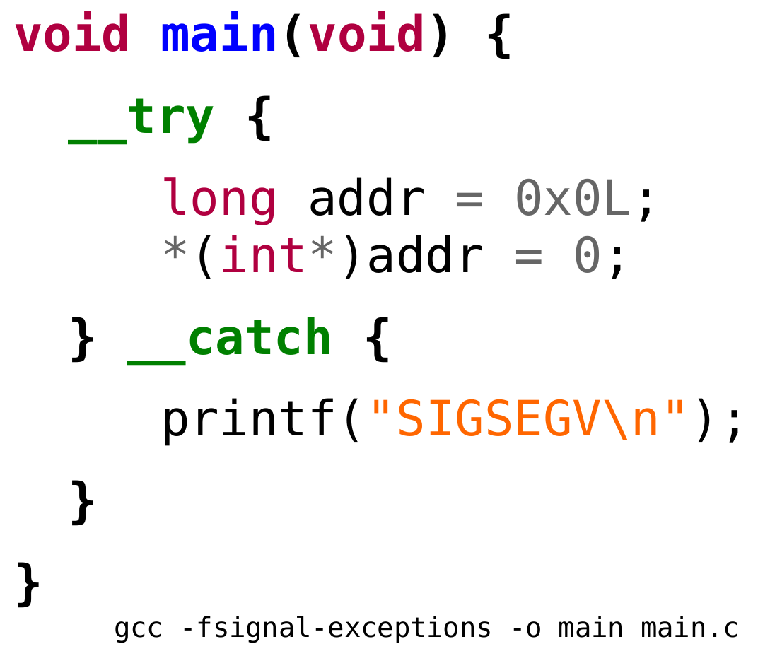
C Language
Digital Design and Verification Training
ThePhoto by PhotoAuthor is licensed under CCYYSA.

Slide 4
Advanced C Concepts - Pointers
Definition: A pointer is a variable that stores the memory address of another variable
Syntax:
Declaring and initializing pointers
int x = 10; int *ptr = &x; // ptr holds the address of x
int *p; // Declare a pointer to an int char *str; // Declare a pointer to a char double *dptr = NULL; // Initialize a pointer to null

Slide 5
Advanced C Concepts - Pointers
Accessing the value pointed to by a pointer
Example:
int x = 42; int *ptr = &x; printf("Value of x: %d\n", x); // 42 printf("Value pointed to by ptr: %d\n", *ptr); // 42 *ptr = 100; // Change the value of x through the pointer printf("New value of x: %d\n", x); // 100

Slide 6
Advanced C Concepts - Pointers
Incrementing and decrementing pointers
Example:
int arr[] = {10, 20, 30, 40, 50}; int *p = arr; // p points to the first element of arr printf("%d ", *p); // 10 printf("%d ", *(p+1)); // 20 printf("%d ", *(p+2)); // 30 p++; // Move to the next element printf("%d ", *p); // 20

Slide 7
Advanced C Concepts - Pointers
Relationship between arrays and pointers
Array name as a pointer to its first element
int numbers[] = {1, 2, 3, 4, 5}; int *ptr = numbers; // ptr points to the first element for (int i = 0; i < 5; i++) { printf("%d ", *(ptr + i)); // Access elements using pointer arithmetic } printf("\n"); // Equivalent array notation for (int i = 0; i < 5; i++) { printf("%d ", numbers[i]); }

Slide 8
Advanced C Concepts - Pointers
Strings in C are arrays of characters terminated by '\0'.
They can be manipulated using pointers.
char str[] = "Hello"; char *p = str; printf("%s\n", str); // using array printf("%s\n", p); // using pointer

Slide 9
Advanced C Concepts - Pointers
Pointers can iterate over characters until '\0' is reached.
char str[] = "Pointers"; char *p = str; while (*p != '\0') { printf("%c ", *p); p++; } // Output: P o i n t e r s

Slide 10
Advanced C Concepts - Pointers
Comparing Array Index vs. Pointer Notation
char str[] = "World"; for (int i = 0; str[i] != '\0'; i++) printf("%c", str[i]); // array indexing char *p = str; while (*p) printf("%c", *p++); // pointer notation

Slide 11
Advanced C Concepts - Pointers
Practical Demo
void magic_func(char *s) { char *end = s + strlen(s) - 1; while (s < end) { char temp = *s; *s++ = *end; *end-- = temp; } }

Slide 12
Advanced C Concepts - Pointers
Accessing elements of 2D arrays using pointers
Example
int matrix[3][4] = {{1, 2, 3, 4}, {5, 6, 7, 8}, {9, 10, 11, 12}}; int (*p)[4] = matrix; // Pointer to an array of 4 integers printf("%d ", *(*(p+1)+2)); // Accesses matrix[1][2], prints 7 printf("%d ", p[1][2]); // Equivalent array notation

Slide 13
Function Pointers - Basics
Definition: Pointers that point to functions
Syntax:
Example:
return_type (*pointer_name)(parameter_types);
int add(int a, int b) { return a + b; } int (*func_ptr)(int, int); func_ptr = add; printf("Sum: %d\n", func_ptr(5, 3)); // Calls add(5, 3), prints 8

Slide 14
Function Pointers – Example
int compare_ints(const void* a, const void* b) { return (*(int*)a - *(int*)b); } int main() { int numbers[] = {42, 13, 7, 87, 35}; int n = sizeof(numbers) / sizeof(numbers[0]); qsort(numbers, n, sizeof(int), compare_ints); for (int i = 0; i < n; i++) { printf("%d ", numbers[i]); } printf("\n"); return 0; }

Slide 15
Common Pitfalls with Pointers
Uninitialized pointers
Dangling pointers
Memory leaks
Best Practices for Using Pointers
Always initialize pointers
Check for NULL before dereferencing
Use const when appropriate
Be cautious with void pointers
Free dynamically allocated memory

Slide 16
Dynamic Memory Allocation
Why use dynamic memory allocation?
Flexible memory usage
Create data structures of variable size
Functions: malloc(), calloc(), realloc(), free()

Slide 17
Dynamic Memory Allocation
malloc()
Allocates specified number of bytes
Syntax: void *malloc(size_t size);
Example:
int *ptr = (int *)malloc(5 * sizeof(int)); if (ptr == NULL) { printf("Memory allocation failed\n"); return 1; } // Use the allocated memory free(ptr); // Don't forget to free when done

Slide 18
Dynamic Memory Allocation
calloc()
Allocates memory and initializes it to zero
Syntax: void *calloc(size_t num, size_t size);
Example:
int *ptr = (int *)calloc(5, sizeof(int)); if (ptr == NULL) { printf("Memory allocation failed\n"); return 1; } // Use the allocated memory free(ptr);

Slide 19
Dynamic Memory Allocation
realloc()
Resizes previously allocated memory
Syntax: void *realloc(void *ptr, size_t new_size);
Example:
int *ptr = (int *)malloc(5 * sizeof(int)); // ... use the memory ... ptr = (int *)realloc(ptr, 10 * sizeof(int)); if (ptr == NULL) { printf("Memory reallocation failed\n"); return 1; } // Use the reallocated memory free(ptr);

Slide 20
Structures
Group related data items
Syntax:
struct Person { char name[50]; int age; float height; }; struct Person p1 = {"Alice", 30, 165.5}; printf("Name: %s, Age: %d, Height: %.1f\n", p1.name, p1.age, p1.height);

Slide 21
Structures
Pointers to Structures
Syntax:
struct Student { int roll; char name[20]; float gpa; }; struct Student s1 = {1, "Ali", 3.7};
struct Student *p = &s1; printf("%s", p->name);

Slide 22
Structures
Nested Structures
Structures within structures
Example:
struct Address { char street[50]; char city[30]; }; struct Employee { char name[50]; struct Address addr; }; struct Employee emp = {"Bob", {"123 Main St", "New York"}}; printf("Name: %s, Street: %s, City: %s\n", emp.name, emp.addr.street, emp.addr.city);

Slide 23
Unions
Shares memory among different data types
Only one member can hold a value at a time
Example:
union Data { int i; float f; char str[20]; }; union Data data; data.i = 10; printf("Integer: %d\n", data.i); data.f = 3.14; printf("Float: %f\n", data.f);

Slide 24
Preprocessor Directives
Handled before compilation.
Categories: File inclusion, Macros, Conditional compilation
#define PI 3.14159 #define SQUARE(x) ((x)*(x))

Slide 25
Preprocessor Directives
Also used for Conditional Compilation
#ifdef DEBUG printf("Debug Mode"); #endif

Slide 26
File I/O - Basics
Key functions: fopen(), fclose(), fread(), fwrite(), fprintf(), fscanf()
File open modes: "r", "w", "a", "r+", "w+", "a+"
Example:
FILE *file = fopen("example.txt", "w"); if (file == NULL) { printf("Error opening file\n"); return 1; } fprintf(file, "Hello, File I/O!\n"); fclose(file);

Slide 27
File I/O - Basics
Reading from a file:
FILE *file = fopen("example.txt", "r"); char buffer[100]; while (fgets(buffer, sizeof(buffer), file) != NULL) { printf("%s", buffer); } fclose(file);

Slide 28
File I/O - Basics
Writing to a file:
FILE *file = fopen("output.txt", "w"); for (int i = 1; i <= 5; i++) { fprintf(file, "Line %d\n", i); } fclose(file);

Slide 29
File I/O - Basics
File I/O Best Practices
Always check if file operations succeed
Close files when done
Use appropriate file modes
Handle errors gracefully
Consider using fflush() for immediate writing

Slide 30
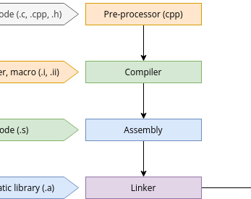
Compilation of C Program
Digital Design and Verification Training
ThePhoto by PhotoAuthor is licensed under CCYYSA.

Slide 31
Assembler Vs Compiler
If the user program is written in assembly language, then we use an assembler to convert it to an object code, which is also called machine code.
If the user program is written in a high-level language, we will take the example of a C program, then we use a compiler to convert it to the machine code.
Notes:
The tool used in the compilation process is called either a compiler or an assembler depending on the type of the user program source file.

Slide 32
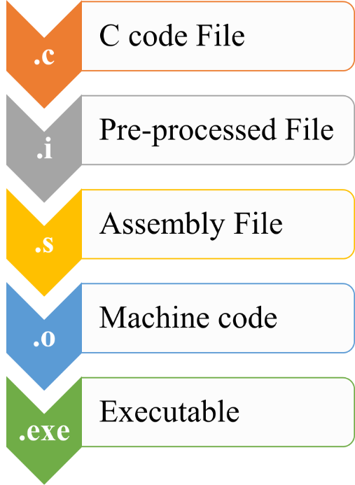
Compilation Process
Preprocessing
Compilation
Assembly
Linking

Slide 33
Compilation Process
Preprocessing
First stage of compilation
Handled by the preprocessor
Processes directives like #include, #define, #ifdef, etc.
Preprocessing - What It Does
Includes header files
Expands macros
Removes comments
Handles conditional compilation directives

Slide 34
Preprocessing - Example
Original code:
After preprocessing:
#include <stdio.h> #define MAX 100 int main() { printf("Max is %d\n", MAX); return 0; }
// Contents of stdio.h inserted here Int main() { printf("Max is %d\n", 100); return 0; }
Preprocessing - GCC Command
gcc -E source.c -o source.i

Slide 35
Compilation
Second stage of the process
Converts preprocessed code to assembly language
Performs syntax checking and optimization
Parses the preprocessed code
Performs semantic analysis
Generates assembly code

Slide 36
Compilation - Example
Original code:
After preprocessing:
int add(int a, int b) { return a + b; }
add: pushl %ebp movl %esp, %ebp movl 8(%ebp), %edx movl 12(%ebp), %eax addl %edx, %eax popl %ebp ret
Preprocessing - GCC Command
gcc -S source.i -o source.s

Slide 37
Assembly
Third stage of compilation
Converts assembly code to machine code
Produces object files
Assembly - Object File Content
Machine code
Symbol table
Relocation information
Debugging information (if compiled with -g)

Slide 38
Linking
Final stage of compilation
Resolves external references
Combines object files into a single executable
Resolves symbols (function calls, variable references)
Assigns final addresses to functions and variables
Links with standard libraries

Slide 39
Linker Types
Static Linking
Libraries are embedded in the executable
Larger file size, but self-contained
Dynamic Linking
Libraries are linked at runtime
Smaller executable, but requires libraries to be present

Slide 40
Compilation steps using gcc
Pre-processing: gcc -E example.c -o example.i
Output pre-processed file example.i can be viewed using any text editor (Notepad++)
Compilation: arm-none-eabi-gcc -S example.i
Output assembly file can be viewed using any text editor (Notepad++)
Linking: gcc -c example.s
In command prompt using: objdump -D example.o
Creating Executable: gcc -o out example.o
In command prompt: out

